Slide 1

LoL Genius
Know more, win more.
Actionable, detailed, ML/AI powered data and analysis
“LoL Genius” isn't endorsed by Riot Games and doesn't reflect the views or opinions of Riot Games or anyone officially involved in producing or managing Riot Games properties. Riot Games, and all associated properties are trademarks or registered trademarks of Riot Games, Inc.

Slide 2
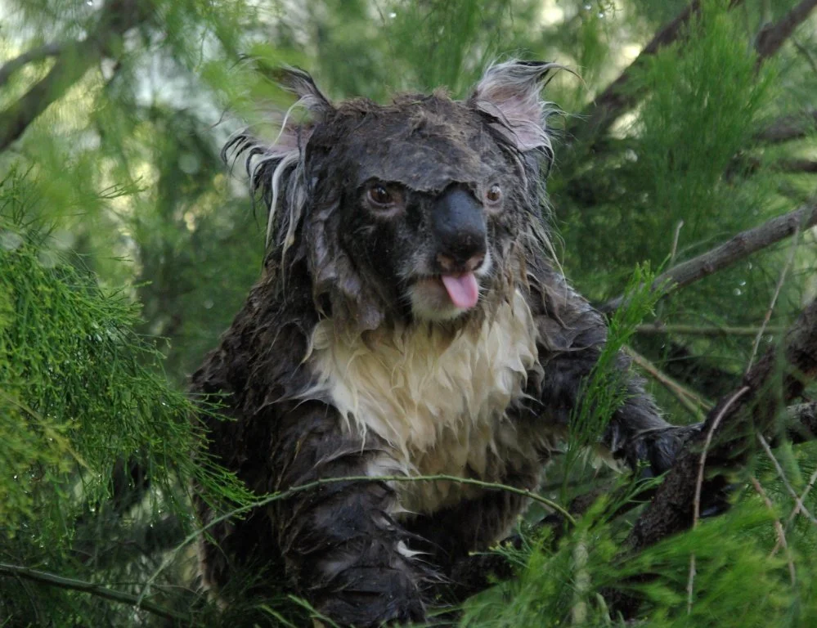



Who am i?
Karl, Aerospace & Computer Science
Graduate Researcher, Data Analyst
Past work and collaborations:
Lockheed Martin
Wells Fargo
Mozilla
Air Force Research Lab
NASA, FAA
Siemens, GSK
Aerojet Rocketdyne
American Institute of Aeronautics and Astronautics
Experience in everything from AI/ML to jet engine design
“Solve difficult problems with novel methods, by any means necessary”
RebirthNA#2359
@LoL-Genius
417devops@gmail.com

Slide 3

League of legends
Played for over 10 years
Ranked since S4
Positional analysis of top 200 players across NA, KR, EUW
Let’s Dive In

Slide 4




What’s out there?
OP.GG
MOBALYTICS
BLITZ.GG

Slide 5

What is offered?
 | Q1 | Q2 | Q3
Match history “at a glance”
Overall profile stats
Short game descriptions
Comparison to other ranks
In-depth game stats
Clean match history overview
Brief account overview
Quick game to game information

Slide 6
What is offered?
 | Q1 | Q2 | Q3
Match history “at a glance”
Overall profile stats
Short game descriptions
Comparison to other ranks
In-depth game stats
Clean match history overview
Brief account overview
Quick game to game information

Slide 7




Conversations with Pro analysts
“Outside of dedicated coaching and professional players’ teams of analysts, there is no easy way to get detailed stats and analysis”

Slide 8
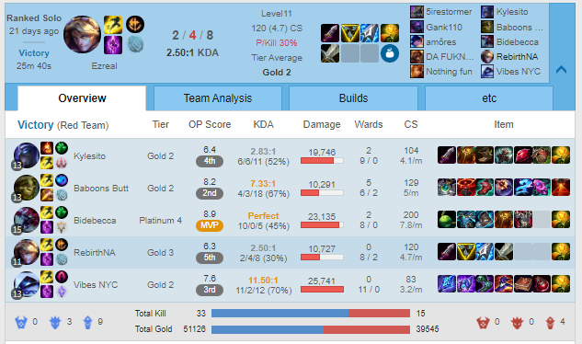
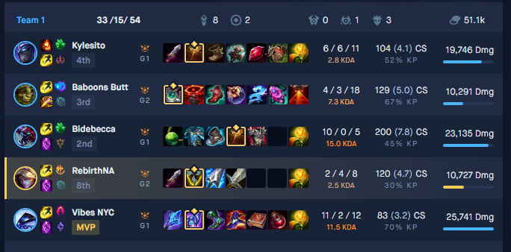
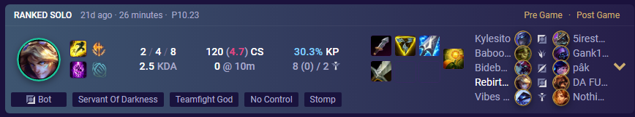
What is missing?
Available match data
Win or loss
Duration
Score line (K/D/A)
Role
End game CS
Kill participation
CS/min
Wards
Champion, items, runes

Slide 9
What is missing?
Surface level match data
Win or loss
Duration
Score line (K/D/A)
Role
End game CS
Kill participation
CS/min
Wards
Champion, items, runes
We need better stats and more of them
We need better stats and more of them

Slide 10
Lol Genius offers more
Surface level match data
ACTIONABLE, ML/AI powered data
Win or loss
Duration
Score line (K/D/A)
Role
End game CS
Kill participation
CS/min
Wards
Champion, items, runes
Economics
Gold earned
Gold spent
Gold efficiency
Gold per minute (across time intervals)
Combat
Damage dealt (total and/or to champions)
Damage taken
Damage per gold
Laning
CS/min for specific time intervals
Creep score difference versus laner for time intervals
Damage taken difference versus laner for time intervals
Jungle and Support
Vision score per minute
Jungle monsters per minute
AND MORE!
We need better stats and more of them

Slide 11
How does this benefit you?
Do you want to get better?

Slide 12









Knowledge is power
You can’t start to improve until you know what to improve.
From a player (Gold -> Diamond)
CS/min intervals showed deficit at 20-minute mark
Allowed them to focus on mid game cs-ing!
Went from Gold to Diamond in less than a month
Know more, win more.

Slide 13
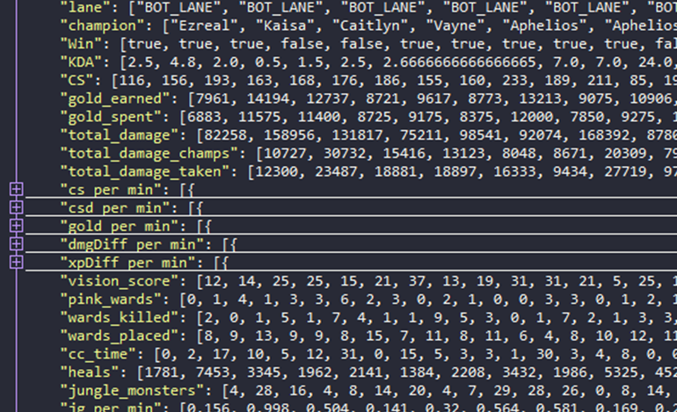
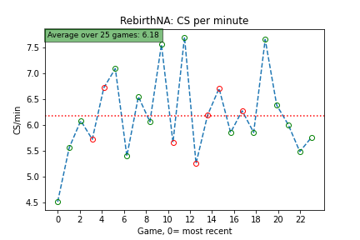
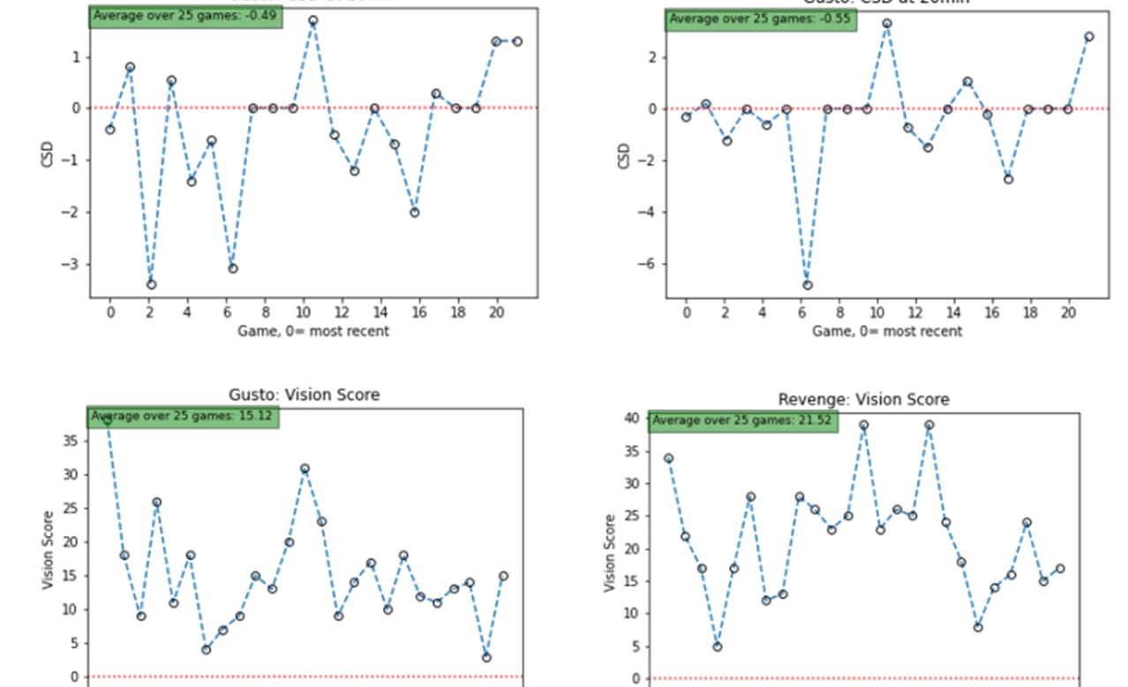
Product tiers
I just want numbers (Tier 1)
Raw data file
Listed stats + basic info
JSON format
I need a little help
(Tier 2)
Short report with info
Pick 5 stats from list (+$1 for each additional)
Performance graphs
Basic analysis
I want to dominate
(Tier 3)
Full presentation + Q&A
All stats & graphs
In-depth analysis
Identification of areas for improvement
Compare to challenger or specific player
FREE
$5.00
$20.00

Slide 14
STAT LIST
Base stats
KDA
Game time
CS
Economics
Gold earned
Gold spent
Gold spend efficiency
Gold per minute (across time intervals)
Laning
CS/min for specific time intervals
Creep score difference versus laner for time intervals
Damage taken difference versus laner for time intervals
Exp difference versus laner for time intervals
Combat
Damage dealt (total, champions, objectives, turrets)
Damage taken
Damage per gold
Jungle/Support
Jungle monsters (base number, not CS)
Jungle monsters per minute
Number of dragons
Number of rift heralds, barons
Heals
CC score
Events
First blood
First tower
First Rift Herald
First dragon, first baron
Vision
Vision score, vision core
Vision score per minute
Average control wards, wards placed, wards killed
Special requests are also accepted
Comparison to pro or top tier player
Any end game stats from match history
Any derivative stats (e.g., damage per gold earned)

Slide 15
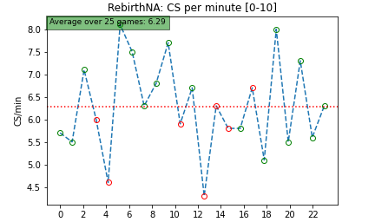
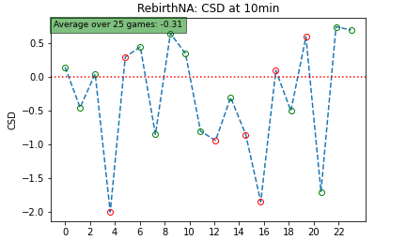
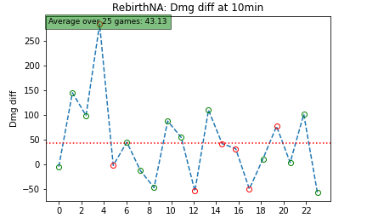
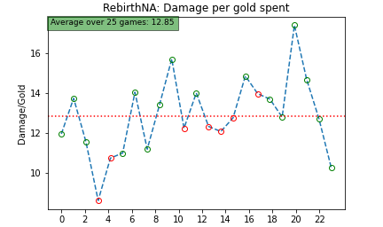
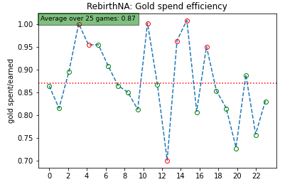
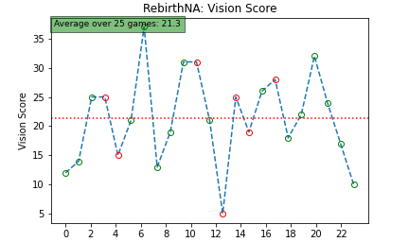
Stat List
Economics
Gold earned
Gold spent
Gold efficiency
Gold per minute (across time intervals)
Combat
Damage dealt (total and/or to champions)
Damage taken
Damage per gold
Laning
CS/min for specific time intervals
Creep score difference versus laner for time intervals
Damage taken difference versus laner for time intervals
Jungle and Support
Vision score per minute
Jungle monsters per minute
Game time
Special requests
Any end game stats
Any derivative stats (e.g., damage per gold earned)

Slide 16

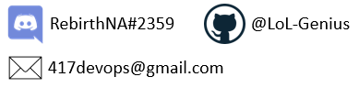
I’m on board! What’s next?
Contact me
What I’ll need:
Summoner name & Region
Role (top, jungle, mid, ADC, support)
Queue (Flex, Solo/Duo, ARAM, etc.)
How many games (default is past 25)*
Which package tier (1, 2, or 3) you want
Have a question or want additional details? Just reach out!

Slide 17
LoL Genius
Know more, win more.
Actionable, detailed, ML/AI powered data and analysis
“LoL Genius” isn't endorsed by Riot Games and doesn't reflect the views or opinions of Riot Games or anyone officially involved in producing or managing Riot Games properties. Riot Games, and all associated properties are trademarks or registered trademarks of Riot Games, Inc.

